Slide 1
Electronic Devices
Final Term Lecture - 10
Reference book:
Electronic Devices and Circuit Theory (Chapter-8)
Robert L. Boylestad and L. Nashelsky , (11th Edition)

Slide 2

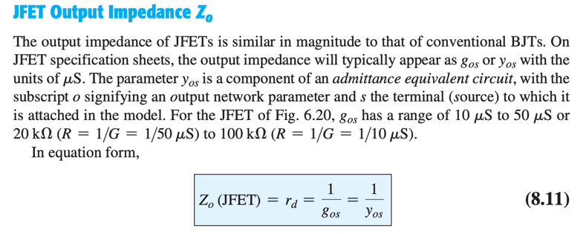
JFET Small Signal Model

Slide 3

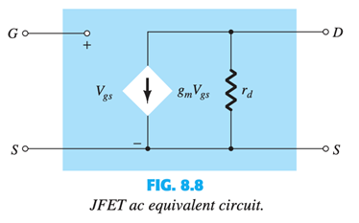
JFET AC Equivalent Circuit

Slide 4

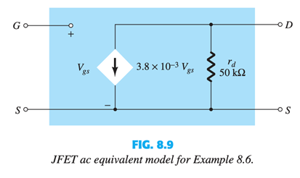
Example

Slide 5

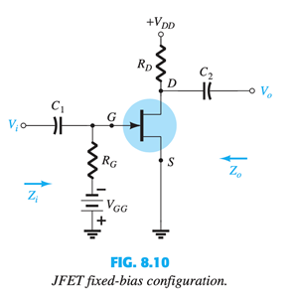
FIXED-BIAS CONFIGURATION

Slide 6
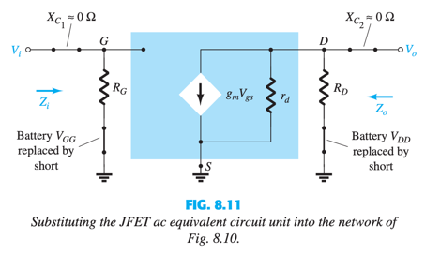
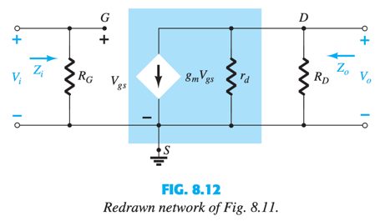
Continued.

Slide 7


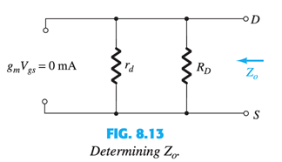

Slide 8
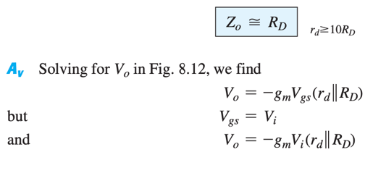
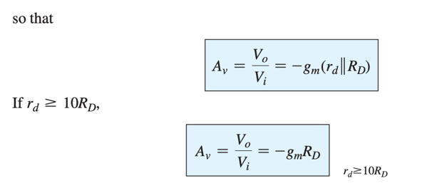

Slide 9

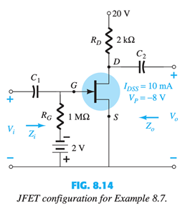

Slide 10





Slide 11
End of Lecture-10

